Slide 1

DASHBOARD
PAGE

Slide 2

HOME
PAGE

Slide 3

Internship
Program

Slide 4

free
internship
PAGE

Slide 5
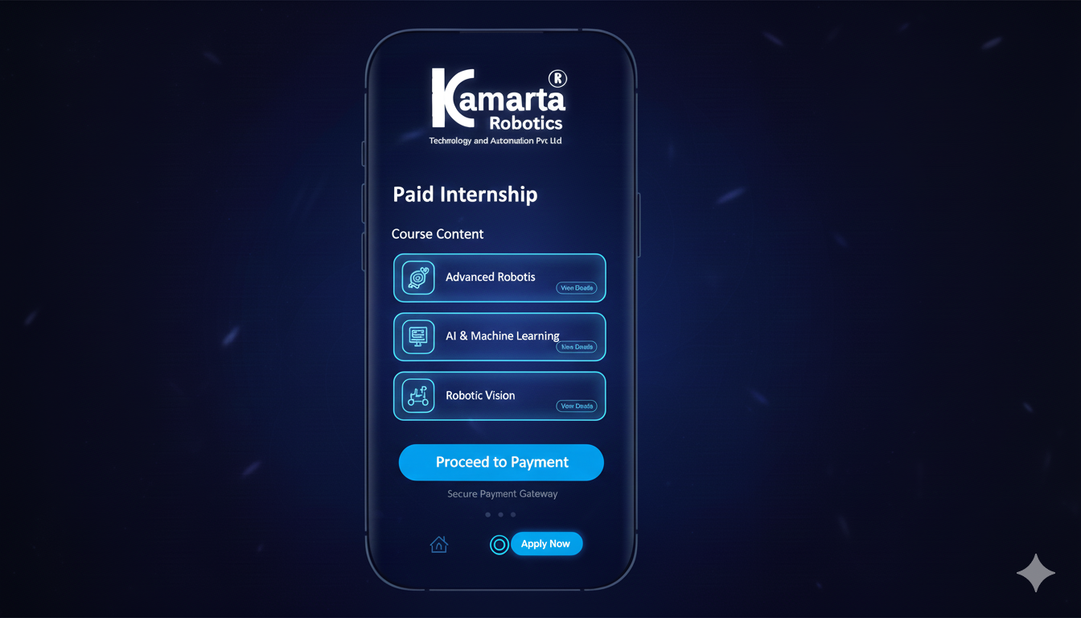
paid
internship
PAGE

Slide 6

About us
PAGE

Slide 7
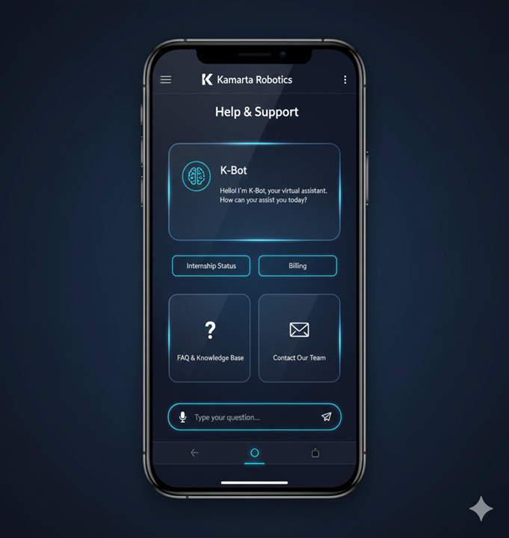
Help & support
PAGE

Slide 8
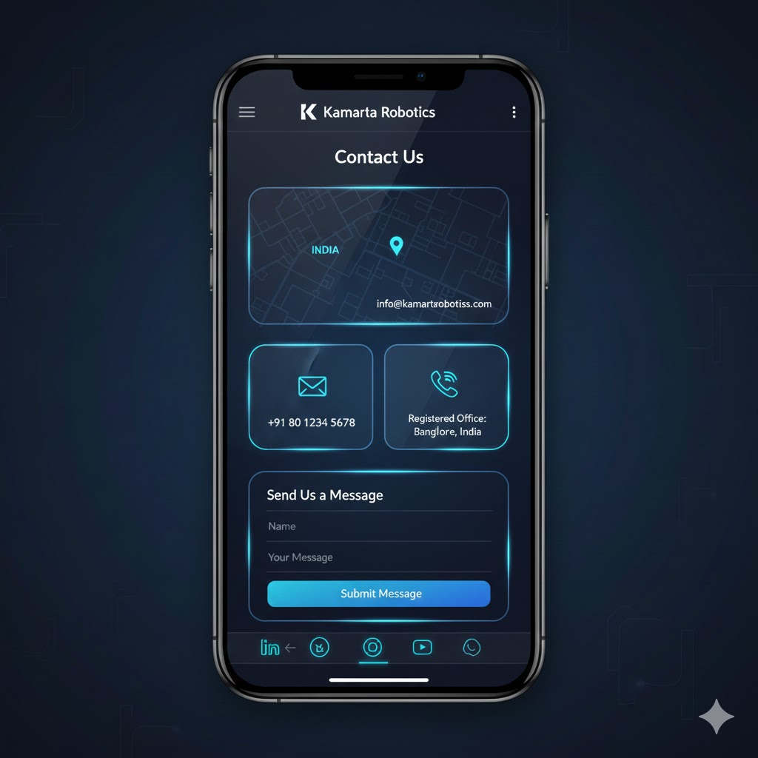
Contact us
PAGE

Slide 9
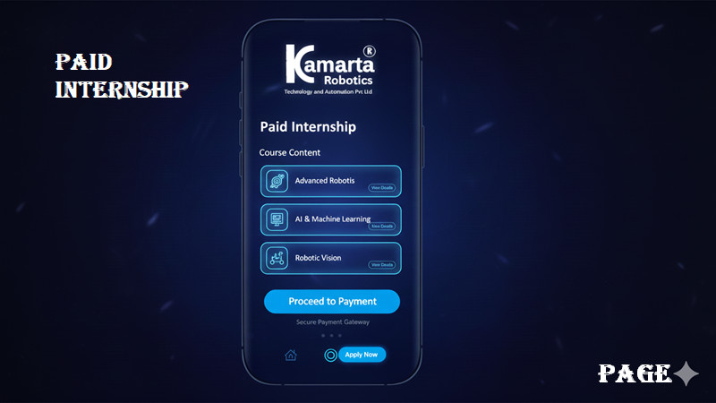
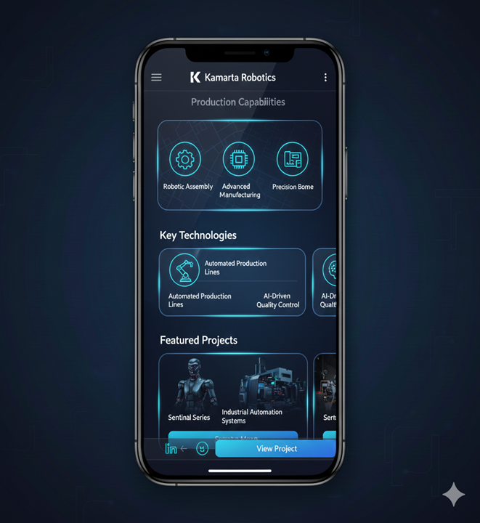
HELP
Production
Page
PRODUCTION

